Slide 1
Course 8 - Software Architecture
Inginerie Software
Anul universitar 2022-2023

Slide 2
Agenda
What is Software Architecture?
Architectural Structures
Good practices in Software Architectures
Software Qualities
Quality Attributes
Quality Attributest Scenarios

Slide 3
How do I use this knowledge?
Observe and evaluate Software Architects on the projects you will work on.
Think like an architect.
Observe, and reflect where you cannot apply.

Slide 4
Software Architecture 101

Slide 5
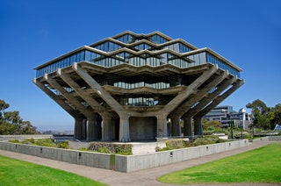
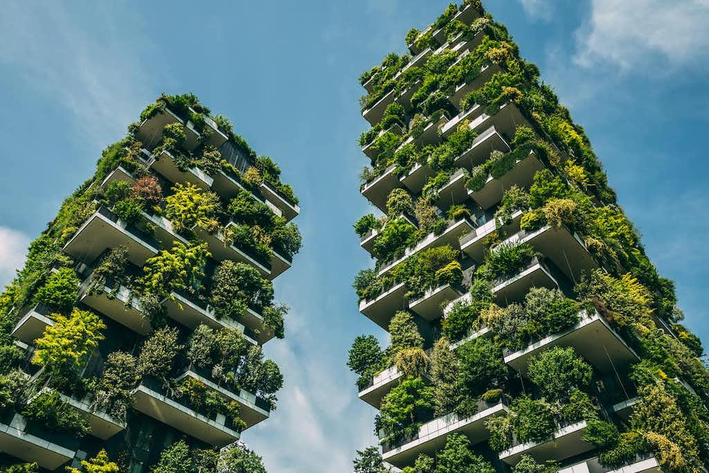


What is Software Architecture?
Geisel Library, University of California, San Diego¹
Bosco Verticale, Milan³
Padoga of Kaiyuan, Dingzhou⁴
State Hermitage Museum, St. Petersburg²
¹https://www.architecturaldigest.com/gallery/brutalist-buildings-on-college-campuses ²https://www.corinthia.com/st-petersburg/discover-st-petersburg/top-10-things-to-see-in-the-hermitage-collection/ ³https://www.greenqueen.com.hk/urban-forest-of-the-future-how-to-turn-our-cities-into-treetopias/the-bosco-verticale-vertical-forest-in-milan-shutterstock/ ⁴https://www.123rf.com/photo_10521896_padoga-of-kaiyuan.html
Notes:
Ca și în arhitectura unei clădiri, arhitectura software descrie un set de structuri folosite pentru a reflecta asupa unui sistem compus din elemente software, relațiile dintre ele, și proprietățile acestora.

Slide 6
Definition
The set of structures needed to reason about the system, which comprise software elements, relations among them, and properties of both.
Bass, Len, Paul Clements, and Rick Kazman. Software Architecture in Practice. 4th edition. Boston: Addison-Wesley Professional, 2021. https://www.oreilly.com/library/view/software-architecture-in/9780136885979/.
Notes:
Ca și în arhitectura unei clădiri, arhitectura software descrie un set de structuri folosite pentru a reflecta asupa unui sistem compus din elemente software, relațiile dintre ele, și proprietățile acestora.

Slide 7
Architectural Structures
Component-and-connector structures
Elements interacting with each other at runtime
Servers, clients, proxies etc. (components)
Call-Return (ex. HTTP reqs.), Pipes (including CI), etc.
Module structures
Set of code or data units to be constructed or acquired
Login component, Database, Test Suite etc.
Allocation structures
Mapping the software structures to non-software structures
Devices that the software should run on, Software changes associated to Issues, Milestones etc.
You can thing about modules as anything that you would make a separate class in Java for
Notes:
In Module structures you can have decomposition.

Slide 8
Good practice in defining Software Architectures
Process recommendations:
A single architect or a small team of architects with a clear technical lead
Base decisions on a prioritized list of well-specified quality attribute requirements
Document architecture through views (perspectives)
Evaluate on the basis of the ability to deliver the system’s important quality attributes.
Structure an incremental implementation plan

Slide 9

Good practice in defining Software Architectures
Structural recommendations:
Well-defined modules (separation of concerns, encapsulation, documented interfaces)
Use well-known patterns and tactics as much as possible.
Control dependencies – refrain from using commercial, but monitor the maintenance of OSS
Data producers should be separate from data consumers
Small simple component interactions – use a single method of communication
Remember log4j?
Notes:
4. new data is added, both sides will have to change, but the separation allows for a staged (incremental) upgrade.

Slide 10
Reflection
What are you able to do in a software system that has a well defined Software Architecture process and structure, that you wouldn’t be able to do otherwise?

Slide 11
Software Qualities

Slide 12
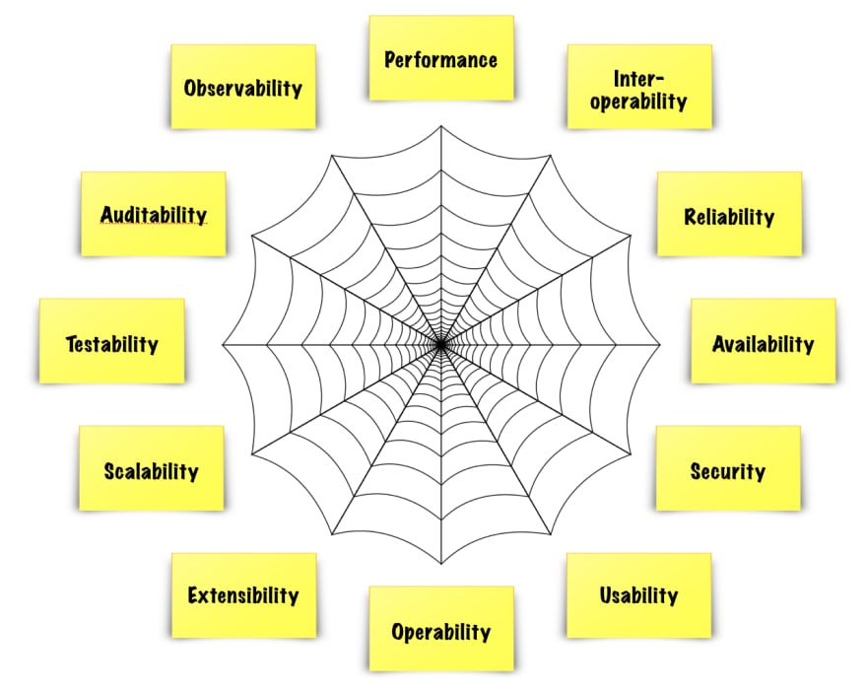
Software Qualities
A quality attribute is a measurable or testable property of a system that is used to indicate how well the system satisfies the needs of its stakeholders beyond the basic function of the system.
https://dev.to/frosnerd/quality-attributes-in-software-1ha9

Slide 13
Functionality vs. Quality
Quality Attributes are closely related to Non-functional requriements
Functionality Requirements | Quality Attributes
Create an account using a valid email address. | Users should immediately change the system assigned password into a secure password.
Create a homepage where the user can see all their information. | Homepage screen should load up in less than 0.2 seconds.
Create a form which would take the user’s data. | Form should be modular, as the required fields are highly dynamic.
Security
Usability
Modifiability

Slide 14
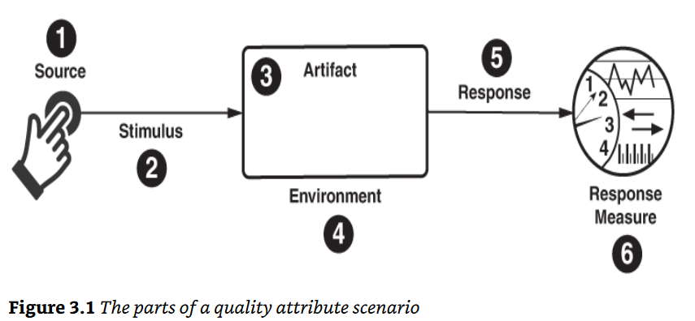
Quality Attribute Scenario
Bass, Len, Paul Clements, and Rick Kazman. Software Architecture in Practice. 4th edition. Boston: Addison-Wesley Professional, 2021. https://www.oreilly.com/library/view/software-architecture-in/9780136885979/.

Slide 15
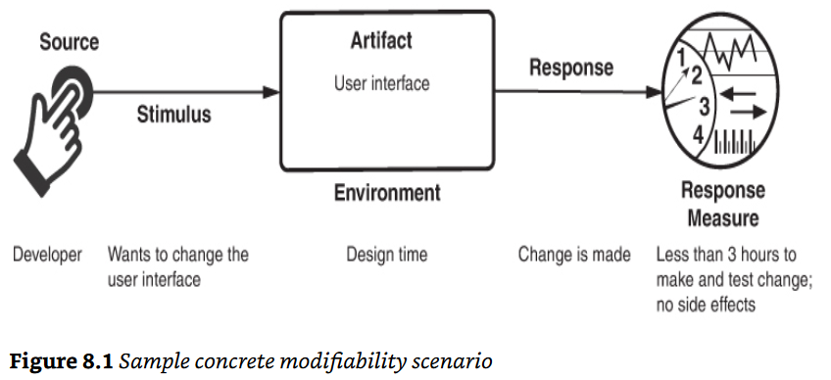
General example of a Modifiability Quality Attribute Scenario

Slide 16
Next week
Architectural Patterns and Tactics
Examples on Quality Attributes Scenarios
Using different views to define an Architecture Documentation
Future in Software Architectures

